Slide 1


Lending Case Study using EDA
By
Renuka Mokka
Veera Nagireddy Mekala

Slide 2
Problem Statement
We need to help a consumer finance company which specialises in lending various types of loans to urban customers in their risk analytics. This company is the largest online loan marketplace, facilitating personal loans, business loans, and financing of medical procedures .
The input data contains information about past loan applicants and whether they ‘defaulted’ or not. The aim is to identify patterns which indicate if a person is likely to default, which may be used for taking actions such as denying the loan, reducing the amount of loan, lending ( to risky applicants) at a higher interest rate, etc.

Slide 3
Data Cleaning
Checked the missing value percentage of input columns and dropped the columns having 60% and above null value percentage.
Imputed the columns having less percentage of missing values using median for continuous variables and “Missing” for categorical variables.
Type casted few columns from int to object (emp id, id) , object to date-time for date related objects, object to int for percentage values(interest rate)
Created Derived column for ‘Charged Off’ column having 1 and 0 values based on loan status.

Slide 4
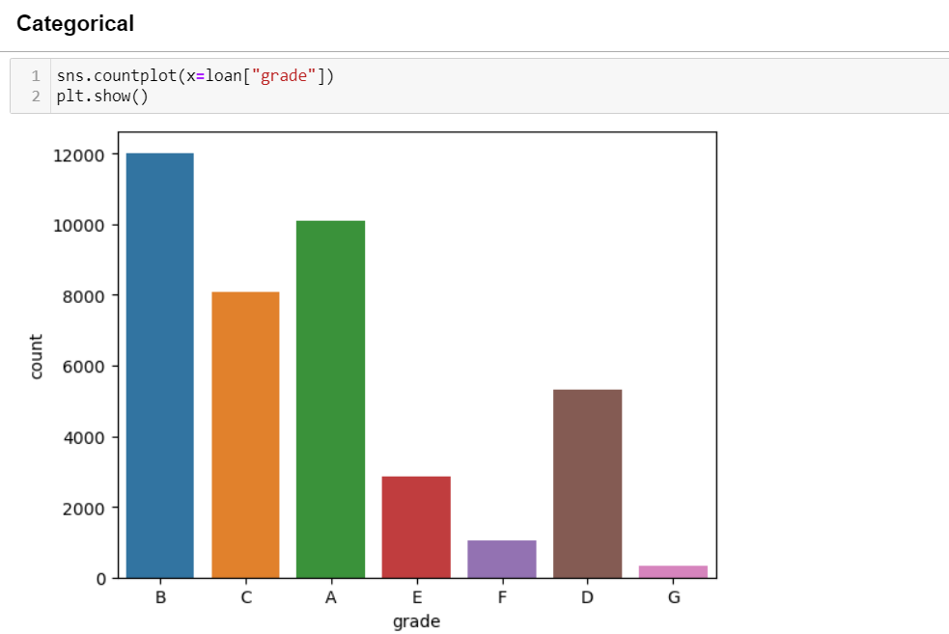
Univariate Analysis

Slide 5
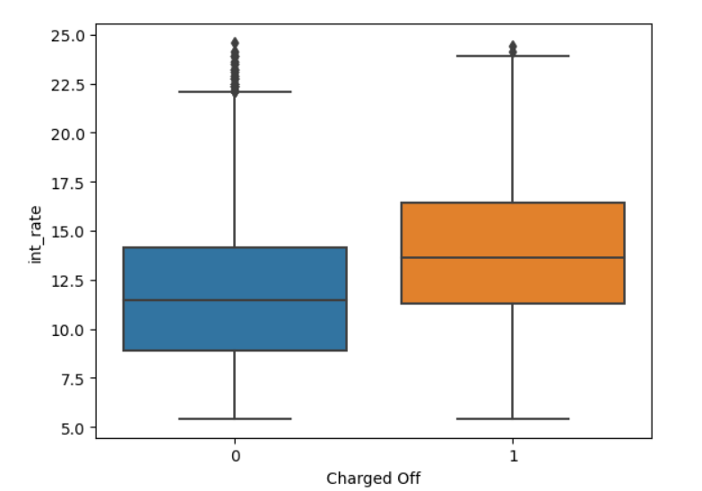
Bivariate Analysis Charged off vs int_rate
Higher the interest rate -> higher chances of Charged Off.
i.e. people who are willing to go for high interest rates, have more probability of being defaulters

Slide 6
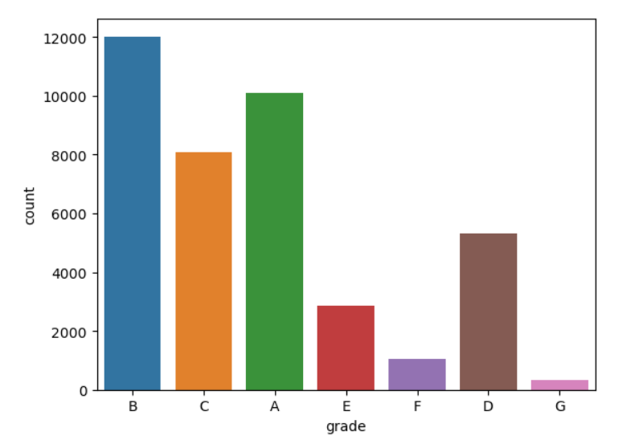
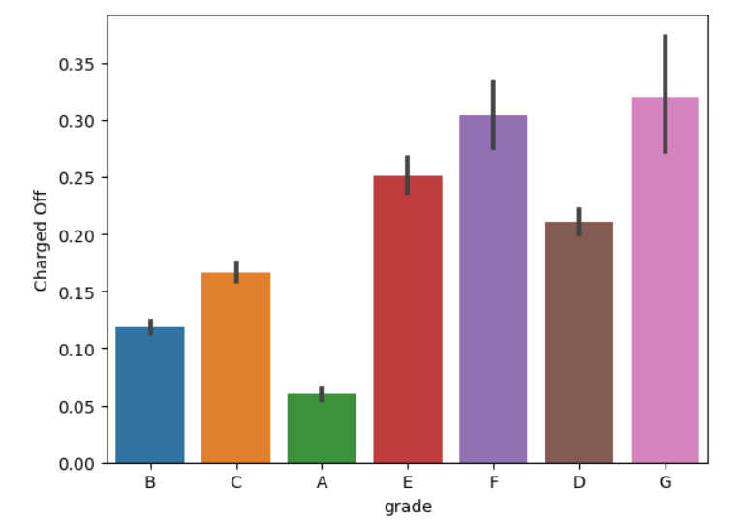
Grade vs Charged-off

Slide 7
Grade vs Charged-off Observations
It's clearly evident that the "grade" is a clear driving factor of loan defaulter.
The lower the grade -> the higher the chances of getting charged off.
G grade is most probable of defaulter and A grade is less probable to default the loan.

Slide 8
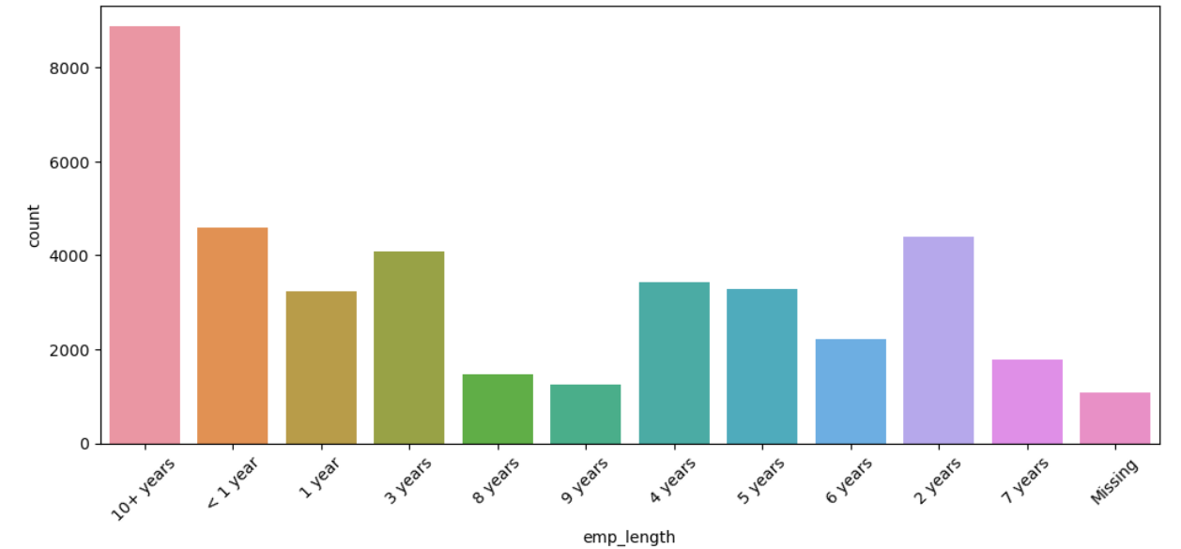
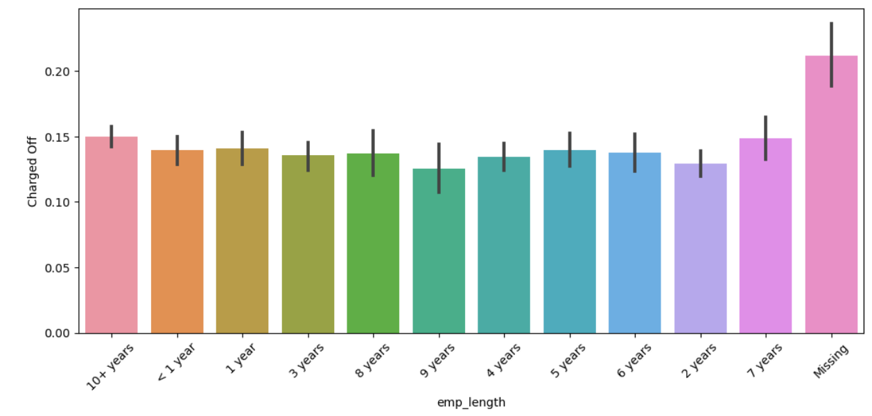
Emp_length vs Charged off

Slide 9
Emp_length vs Charged off Summary
From the above charts Emp_length vs charged_off and emp_length count charts, it's clear that though emp_length missing has less count, they are more probable to default the loan. (Here assumed that missing emp_length means, he is not working in a stable job anywhere, hence it’s data not captured in input data)
Emp_length 10+ has huge count in the data, but their charged off seems similar with other data values, hence it shows that 10+ employees, have less probable to default the loan.
Hence, it's always advisable to offer loan to employees having stable service period, it's advised to go for employment history and then approve the loan.

Slide 10
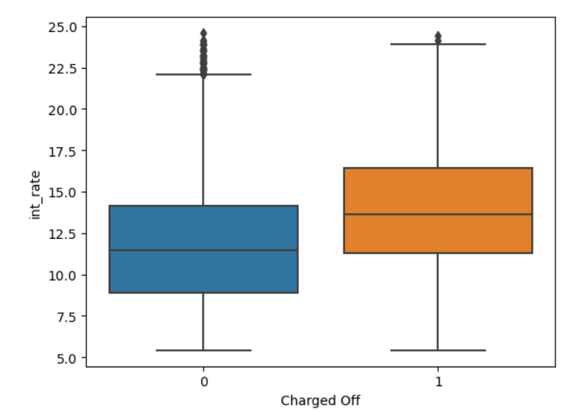
Charged Off vs int_rate
Charged Off vs int_rate shows higher the interest rate , higher chances of Charged Off.
i.e., people who are willing to go for high interest rates, have more probability of being defaulted.

Slide 11
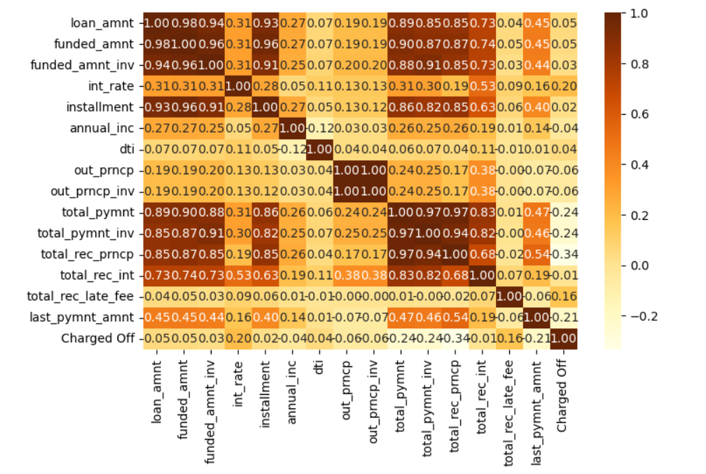
Multivariate Analysis

Slide 12
Multivariate Analysis Summary
From Charged off vs Int_rate and heatmap , it is understandable that Charged Off is being driven by int_rate ,Total principle received and last_payment_amnt.
We can observe that more the interest rate, more chances of being charged off. Also, higher the principal amount, higher chances of defaulter.

Slide 13
Data Insights
The Driving factors of Charged_off (loan default) are:
Grade – The lower the grade -> the higher chances of Charged off
Int_rate – Observed that people who opt for high interest_rate, has more chances of charged_off
Emp_length -> Better to check for emp_length, as persons whose emp_length blank has more chances of charged_off.
Total_Principal_received and Last_Payment_Amount – they are slightly correlated

